Slide 1
Fidelity Investments
Virtual Benefits Fair

Slide 3
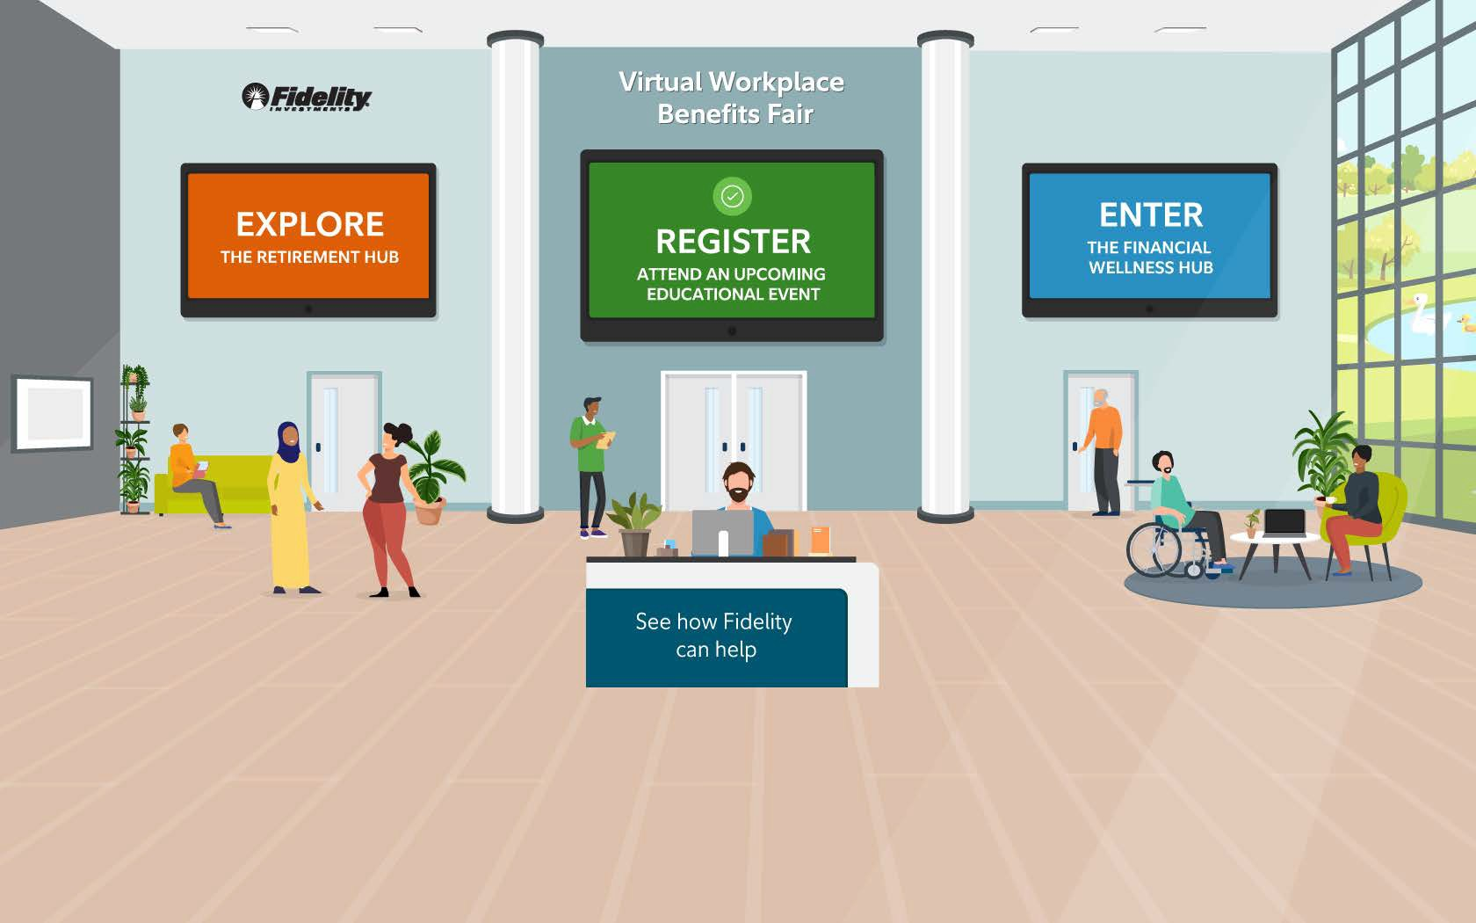
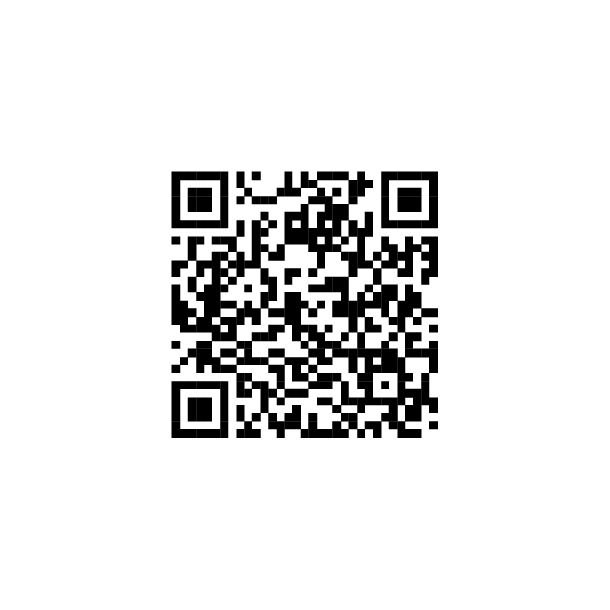
Fidelity Virtual Benefits Fair
Start exploring the Virtual Beneﬁts Fair today! Click or Scan below:
Visit the fair now

Slide 4
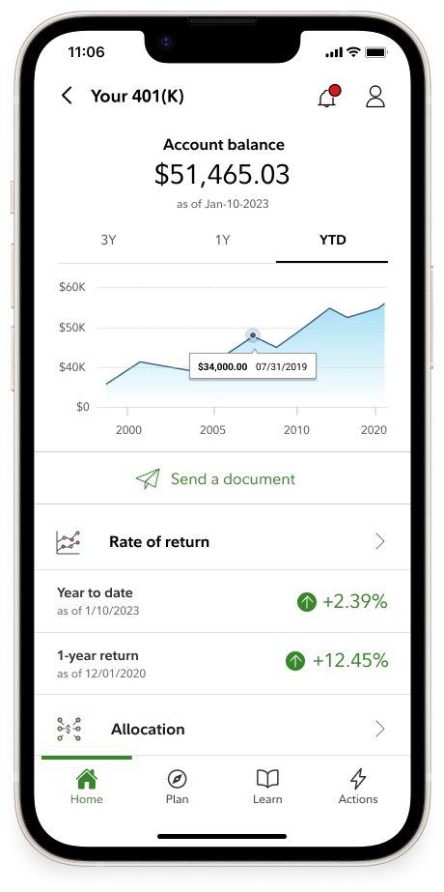
Tools/Resources
Financial Wellness
Financial Wellness Checkup See where you stand and how you can take simple steps to gain more control of today’s financial challenges.
Student Debt
Take control of your student loans Explore different repayment strategies using your real loan information to see if there’s a better way to pay off your loans for good.
Budget and Debt Digital Resources
Article: 5 Steps to Take Control of Your Finances Article: Should I Buy or Keep Renting? YouTube: How To Pay Off Debt
Saving and Spending
Power of Small Amounts See how a small change—1%, 3%, or 5%— can make a big difference.
Savings and Spending Checkup See how your savings and spending compare.
457(b) Contribution Calculator Helps you determine the maximum contribution to your 457(b) plan.
Take-Home Pay Calculator See how your pre-tax contribution might affect your take-home pay.
Attend a Workshop
 |  | Join Fidelity for an educational workshop, where you'll learn strategies and tips to help you manage your financial future with confidence.
NetBenefits.Fidelity.com/livewebmeetings. Learn more about your workplace retirement savings plan at your convenience through on-demand, self-paced learning modules that provide financial education on a variety of topics, including:
 | ➢ Budget and debt management ➢ Saving for multiple goals | ➢ Budget and debt management ➢ Saving for multiple goals | ➢ Understanding your spending ➢ Creatin a rainy-day fund
 | ➢ Managing unexpected events and expenses | ➢ Managing unexpected events and expenses
 | Log on to netbenefits.fidelity.com/ondemandmeetings to learn more. | Log in to netbenefits.fidelity.com/ondemandmeetings to learn more.
Download the NetBenefits mobile App | Download the NetBenefits mobile App
 | Prefer a mobile experience?​ You can also download the NetBenefits® smartphone app for on-the-go access to your Fidelity workplace accounts.​ Download the NetBenefits® app today for an Apple, Android, or Amazon device.​ | Prefer a mobile experience?​ You can also download the NetBenefits® smartphone app for on-the-go access to your Fidelity workplace accounts.​ Download the NetBenefits® app today for an Apple, Android, or Amazon device.​ ​
Prefer to speak with someone?
Schedule a complimentary consultation with your dedicated Fidelity Workplace Financial Consultant, Ashley Bove. Go to fidelity.com/schedule, call 800.642.7131 or text TALK to 343898.*​

Slide 5
Learn More
Learn more about how Fidelity can help you
Schedule a meeting or call 800-642-7131
Call 800-343-0860 to speak to a Fidelity Representative
Visit Fidelity’s dedicated site for State of Rhode Island employees

